Slide 1
Women in Python Web Requests
Paul Hamilton
TroubleMaker, Shenzhen
2019-12-18

Slide 2
Thank You
To TroubleMaker for hosting the event
To Linda for organising the W-i-Python classes
You all for coming along

Slide 3
Python HTTP REQUESTS Library
The ‘requests’ module is an elegant and simple HTTP library for Python, built for human beings.
You make a webpage request (http request) and the remote webserver will respond back to your request. Hopefully with some kind of interesting data that you can use.

Slide 4
Python PILLOW Library
The Python Imaging Library adds image processing capabilities to your Python interpreter.
The library provides extensive file format support, an efficient internal representation, and fairly powerful image processing capabilities.
The core image library is designed for fast access to data stored in a few basic pixel formats. It provides a solid foundation for a general image processing.

Slide 5
Downloading the Lesson files
Run the following command at the command line to download the lesson files or download via zip file:
git clone https://github.com/Parkview785/Woman-in-Python-Web-Requests

Slide 6
Python 3 Module Requirements
You might need to install these modules:
Installing Python modules (Windows):
python --version # you should have 3.6, 3.7, 3.8
Check what modules are installed:
py -3 -m pip list
py -3 -m pip install requests
py -3 -m pip install Pillow

Slide 7
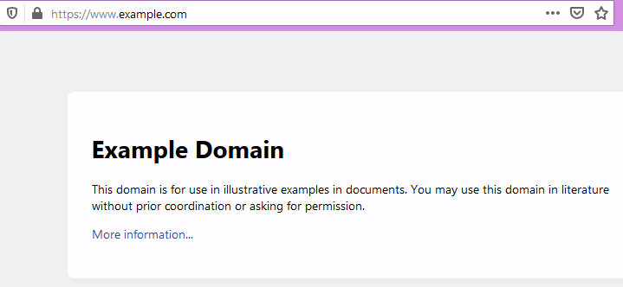
1.1 Lets check this basic webpage:

Slide 8
Lesson 1.1 List out some common Requests types
r = all the information that was returned from the request. We can examine each individual section:
python
import requests
r = requests.get(‘https://www.example.com/’)
print(r.url)
print(r.headers)
print(r.encoding)
print(r.text)

Slide 9
Lesson 1.2 Adding a simple function
Lets add a function to nicely display Header dictionary Text:
Edit this file: 1.2.GeneralRequest.py
def listHeaders(headerText):
''' This is a simple function'''
print("Nicely list headers:")
for key in headerText:
print(key,": ", headerText[key])

Slide 10
Lesson 2.1 Controlling RGB LEDs via HTTP
RGB stands for: Red – Green – Blue Red = ff0000, Green = 00ff00, Blue = 0000ff
Run the program: 2.1.displayTest.py
Examine the code
response = requests.get('http://1.3.3.7/cc?pixels='+teststring)
Try it your self. Try editing the ‘teststring’

Slide 11
Lesson 2.1a
Copy and edit file: 2.1a.displayTest.py
Delete the red lines, keep the BOLD line:
# display a pre-coded string of RGB values
print("Display Test Pixels:")
try:
# will fail miserably if the WiFi connection is lost. Try and make it a nicer with Try/Except
response = requests.get('http://1.3.3.7/cc?pixels=' + teststring)
except ConnectionAbortedError:
print("Lost WiFi connection. Exciting program")
exit()
except:
print("Something else went wrong. Exciting program.")
exit()
print("Webserver says: ", response)
What error did you get and why? How to fix the error?

Slide 12
Lesson 2.2 display some static data to LED Matrix
Run the code: 2.2.displayTest.py
Examine the code:
Display Skull string of RGB values
Display SW Makers string of RGB values
Loop and display a string of random RGB numbers up to display

Slide 13
Lesson 3.1 Uploading an image
Run the code: 3.1.display-JPG2Matrix.py
Examine the code:
Image processing is done with the pillow (PIL) library
Image file import
Re-size image down to 16 pixels by 16 pixels
Display the new image onto laptop
Save a local copy of the image to your laptop
Upload image onto matrix

Slide 14
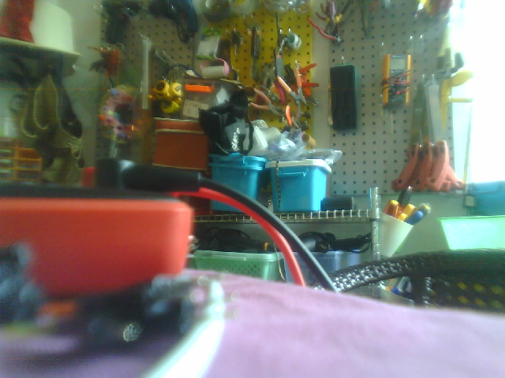
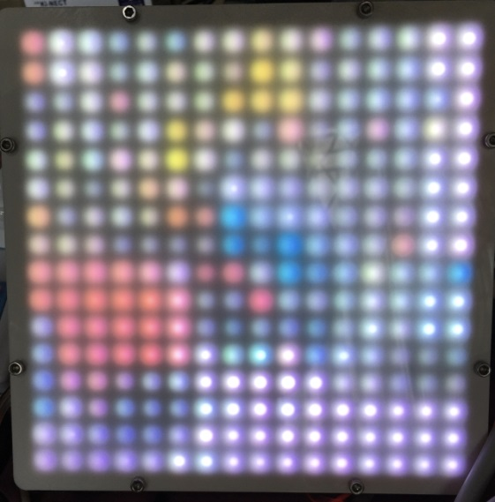
Example photo and after it’s been re-sized to 16x16 pixels
and displayed on the LED Matrix

Slide 15
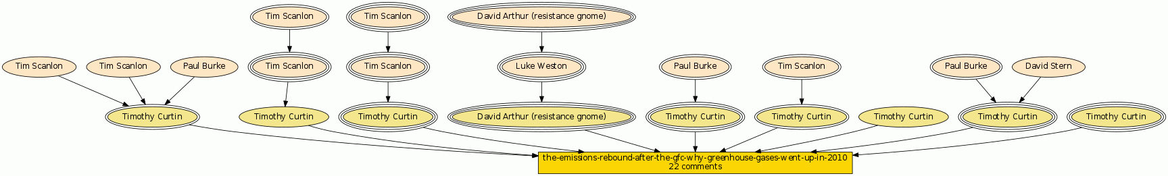
What have I used ‘requests’ for?
Extracting and graphing Website comments:
http://forum.swmakers.org/viewtopic.php?f=9&t=188&sid=23c37aa15806201c5ae4c08eb28cc12a
Remotely controlling the 16x16 LED Matrix
Online trading via Python and Web API’s.

Slide 16
What have I used PIL for?
Lots of things:
Image rotation
Adding text onto images
Pythonic Graphics creation
Image overlays
Photo editing
….
It’s a VERY handy and worth while Python Library to learn.
PS: PIL would make a very interesting W-i-P class

Slide 17
Further Reading
BeautifulSoup
is a Python library for parsing HTML and XML documents. It is often used for web scraping. BeautifulSoup transforms a complex HTML document into a complex tree of Python objects, such as tag, navigable string, or comment.
You could create your own webpage link crawler.
Webpage automatic image downloader
Web Bot
Read up on HTML syntax
Read up on what Pillow can do to your graphic files

Slide 18
WEB REQUESTS The End
Paul Hamilton
Australia

Slide 19
Bonus Material
Discussion:
What might YOU be able to use this for?
How could web developers use this technique?
Can you upload a 16x16 single color, say: red, Green or Blue? (Hint: have a look at: 2.2.display-JPG2Matrix.py)

